Slide 1
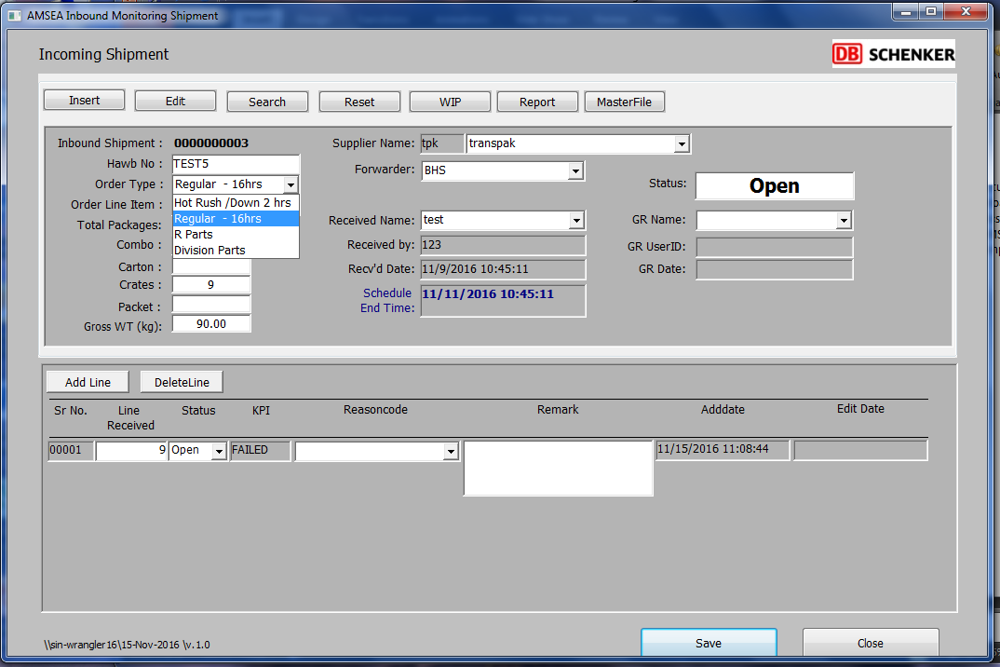
Once status selected, generate list of shipment with check box to change line item status to Docs Received
Status:
Receive at Docks
Docs Received
WMS Received
Completed
MO/AWB/DO:
Order Type:
Regular – 24hrs
Hot Rush – 2hrs
Remarks Text Box
No. of crates (compulsory field) need to be filled before documents are passed to SCC
Remarks:
Add Compulsory ‘ASN#’ Field which need to be entered before status ‘Completed’

